Slide 1

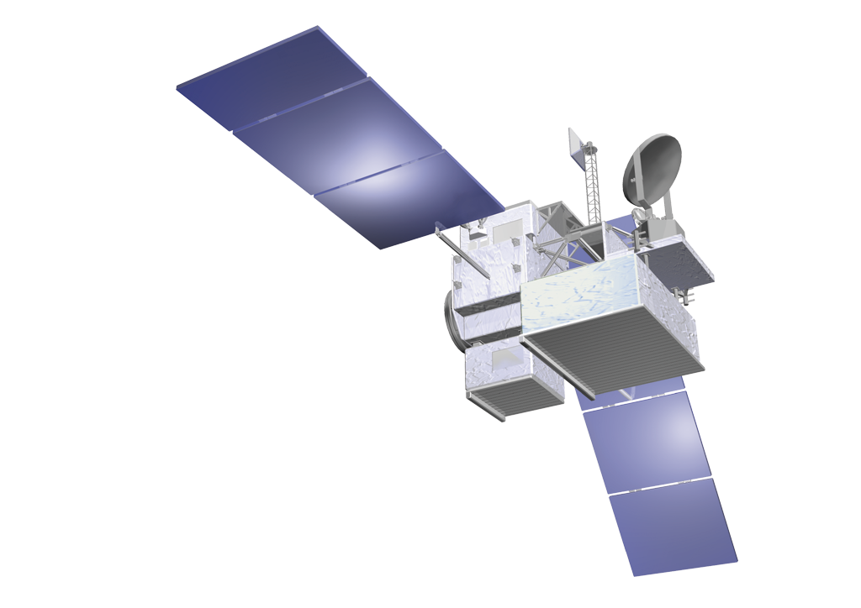
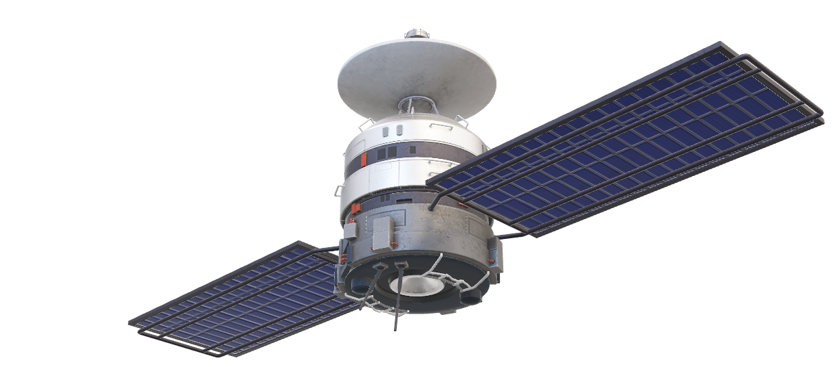
CubeSAT

Slide 2
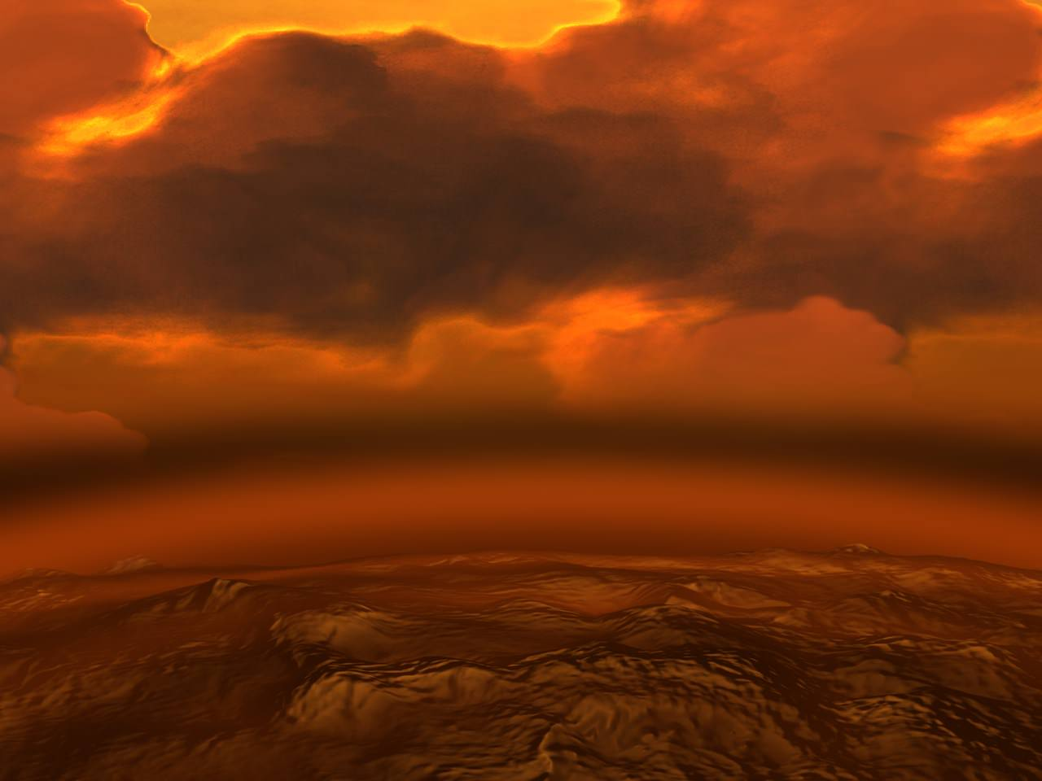
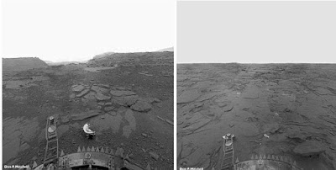
PROBLEMS
High Temperature
High Pressure
Thick Clouds of Sulfuric Acid
Long days and nights
Communication
Solar storm
Acid rain
This Photo by Unknown Author is licensed under CC BY

Slide 3
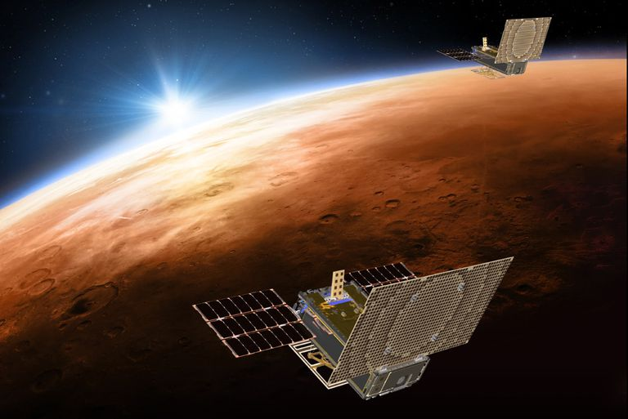
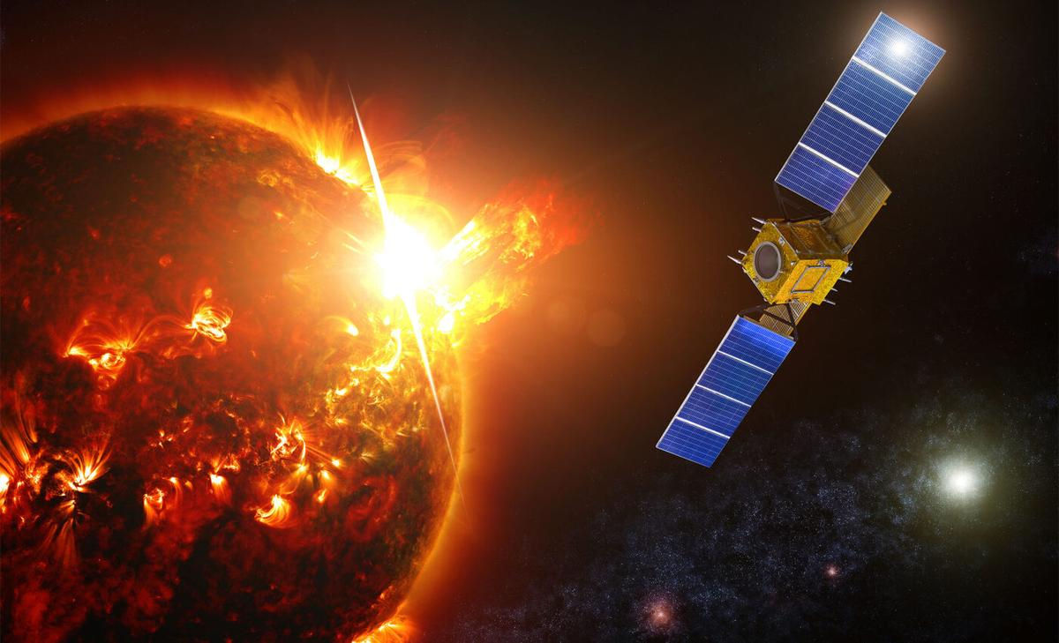
FOR SATELLITE PROTECTION
FOR THERMAL INSULATION
SOLAR STORM

Slide 4
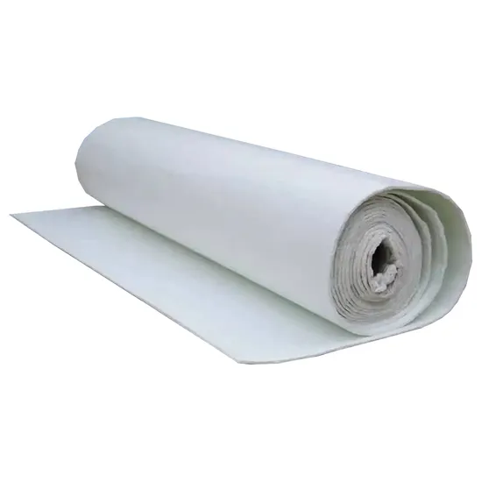

SILICA AEROGEL
Excellent Thermal Insulation
Lightweight
support material for sensors and instruments.
Durability (for long term space mission)
Low density
Transparency
Suitable for venus condition

Slide 5
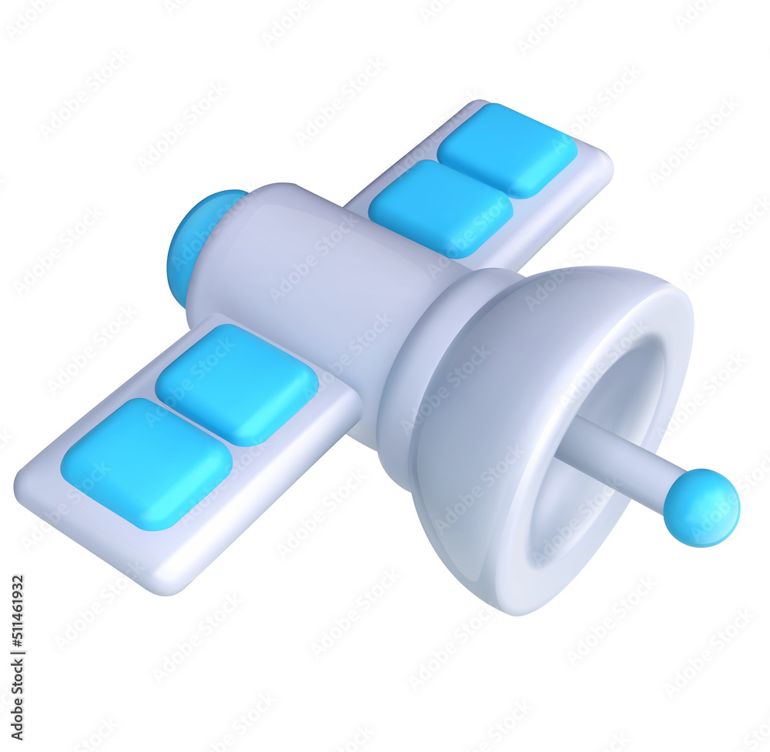

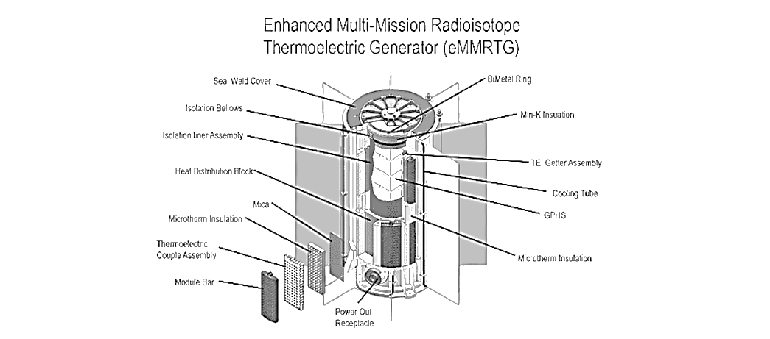
Power?
Radio isotope thermoelectric generator
RTGs
heat is harnessed and converted into electricity
consistent and reliable source of power
inadequate for deep space travel due to fuel limitations and lack of solar power in distant regions.
generating heat through the decay of radioactive materials

Slide 6
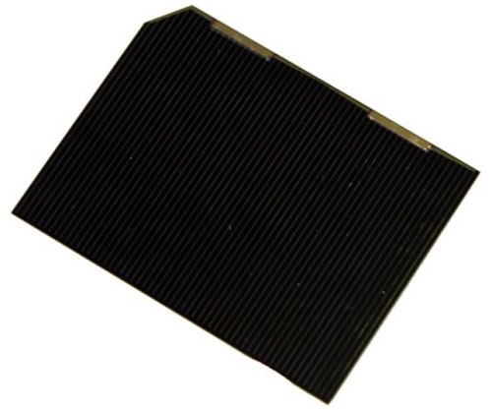
Gallium arsenide (GaAs) solar cells
High efficiency
Radiation resistance
Lightweight
Thermal stability
Q.Main purpose of GaAs ?
:-power generation in Venus’s harsh environment

Slide 7
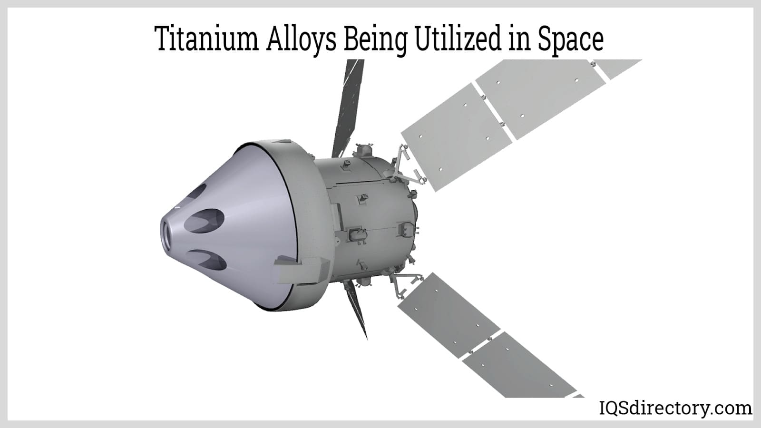
Corrosive resistance material
Titanimum alloy
Corrosion resistance in harsh condition of venus
Maintain mechanical properties at elevent temperature
Reduse overall satellite weight , improve launch efficiency

Slide 8
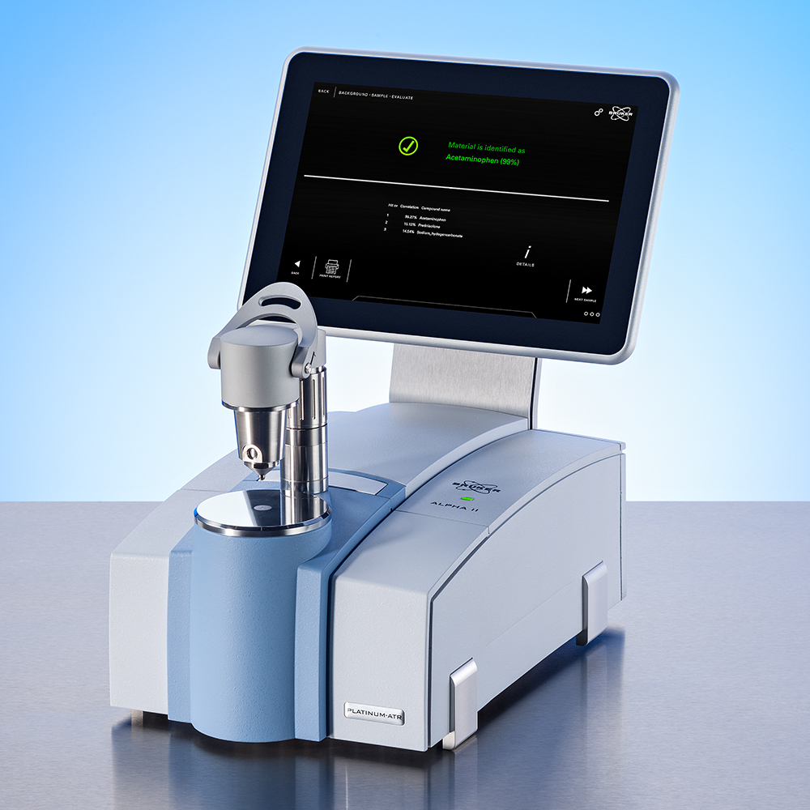
Infrared spectrometer
To study the venus atmosphere
To analyze the venus composition
To study any greenhouse effect present
Identify material and minerals on Venus

Slide 9
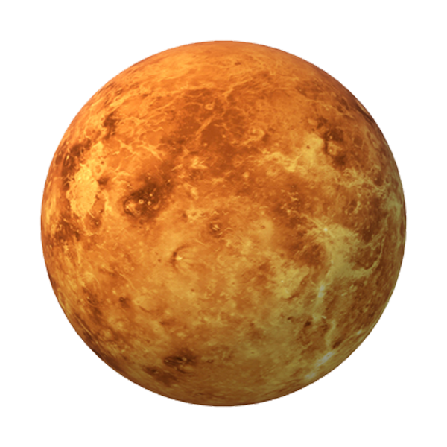


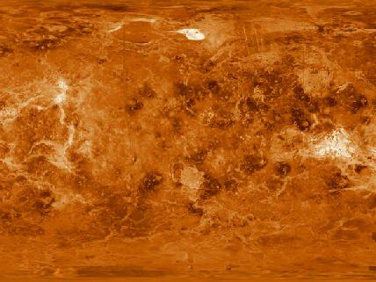
How can I study this football
Synthetic Aperture Radar (SAR)

Slide 10
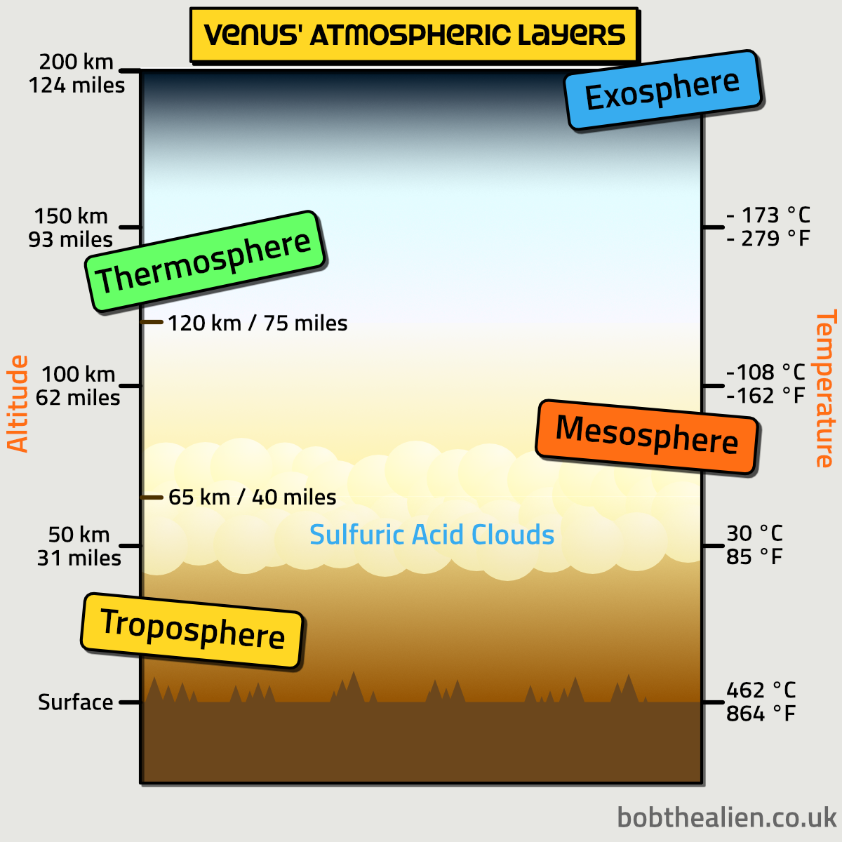
How to control the satellite ?
Reaction control system
Cold gas thruster
Hyper propellent thruster
Electric thruster

Slide 11

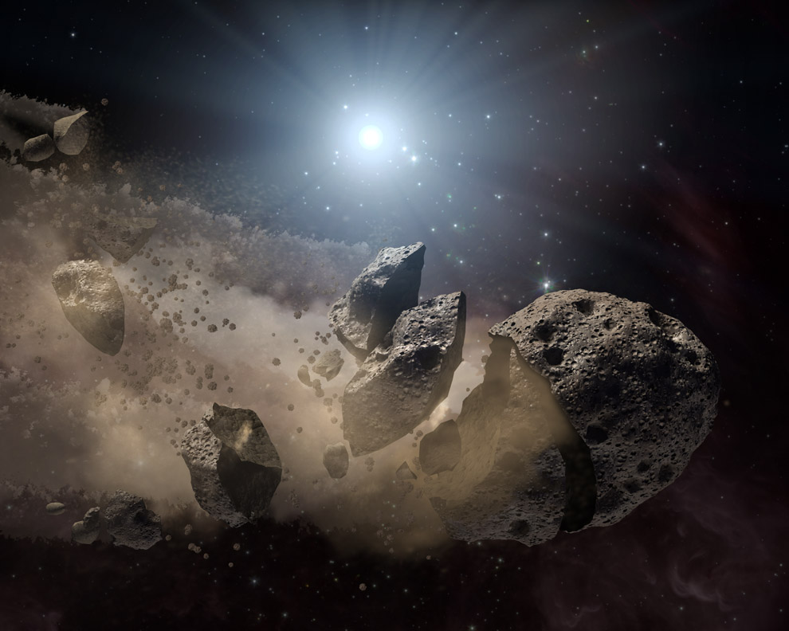
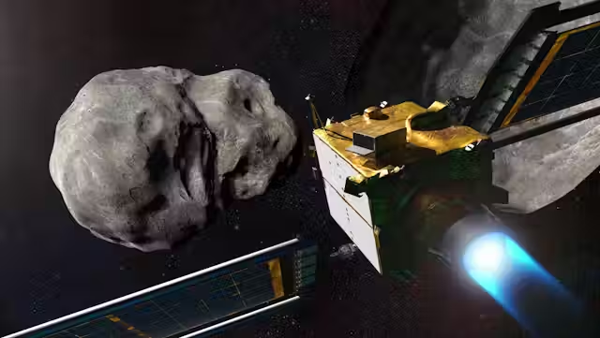
Redundant System
ensures that if one component fails, another can take over
Backup
Recovery
Fault detection
enhancing reliability and mission lifespan

Slide 12
Communication
Radio Frequency (RF)
penetrate the dense atmosphere of Venus better
The best lightweight method for communication in a Venus mission
Antenna
high-gain directional antennas to focus the signal, improving range and reducing interference
better signal strength
Take less surface area

Slide 13
Mass distribution
Payload: 250 g
Communication Systems: 200 g
Power Systems: 200 g
Structure and Thermal Protection: 150 g
Control Systems: 100 g
Total Mass: 1 kg

Slide 14

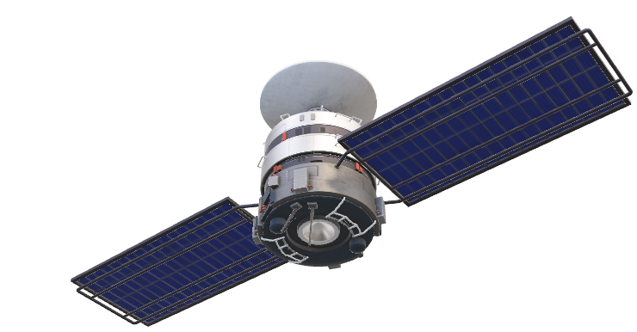
Thank you

